Slide 1
Implementation of distributed ML
Yue Wang

Slide 2
Implementation of distributed ML
Lock and lock-free
Partition data and sampling data
Share memory and parameter server
Under parameter server
Decentralize architecture

Slide 3
asynchronous
Share memory
Lock or lock-free
Parameter server
Partition or sampling data
When to sync
Decentralize

Slide 4
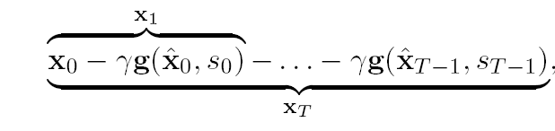

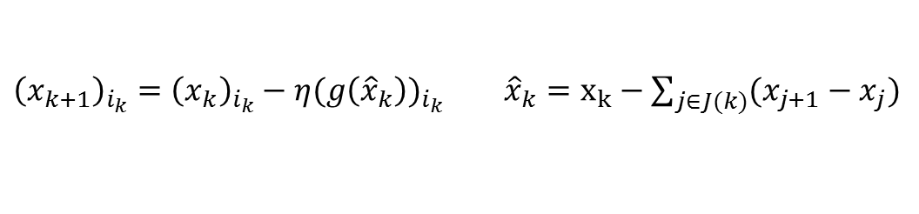

Lock and lock-free
$$x_{j+1}=x_{j}−ηg(x_{j−τ})$$
Consistent read
Inconsistent read
${\left(x_{k+1}\right)}_{i_{k}}={\left(x_{k}\right)}_{i_{k}}−η(g{\left({\hat{x}}_{k}\right))}_{i_{k}}$ ${\hat{x}}_{k}=x_{k}−\sum_{j∈J(k)}{(x_{j+1}−x_{j})}$
Recht, Benjamin, et al. "Hogwild: A lock-free approach to parallelizing stochastic gradient descent." Advances in Neural Information Processing Systems. 2011.
Liu, Ji, et al. "An asynchronous parallel stochastic coordinate descent algorithm." Journal of Machine Learning Research 16.285-322 (2015): 1-5.

Slide 5
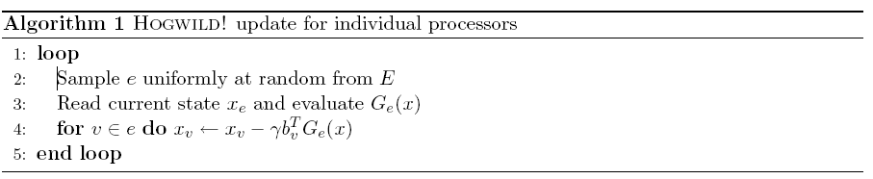
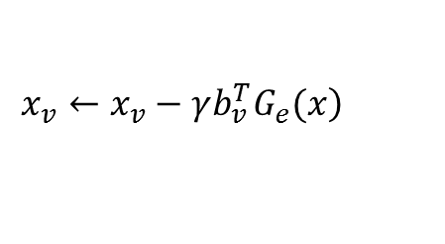
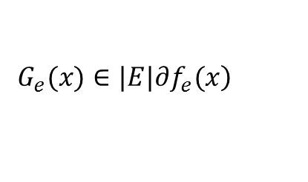
Lock and lock-free
$$\left.G_{e}(x)∈|E|∂f_{e}(x\right)$$
$$\left.x_{v}←x_{v}−γb_{v}^{T}G_{e}(x\right)$$
Assume
only a single coordinate per sampled hyperedge is updated (i.e.,the for loop in Hogwild! is replaced with a single coordinate update);
the authors assumed consistent reads, i.e., it was assumed that while a core is reading the shared variable, no writes from other cores occur;
the authors make an implicit assumption on the uniformity of the processing times of cores (explained in the following), that does not generically hold in practice

Slide 6
Partition data and sampling data

Slide 7
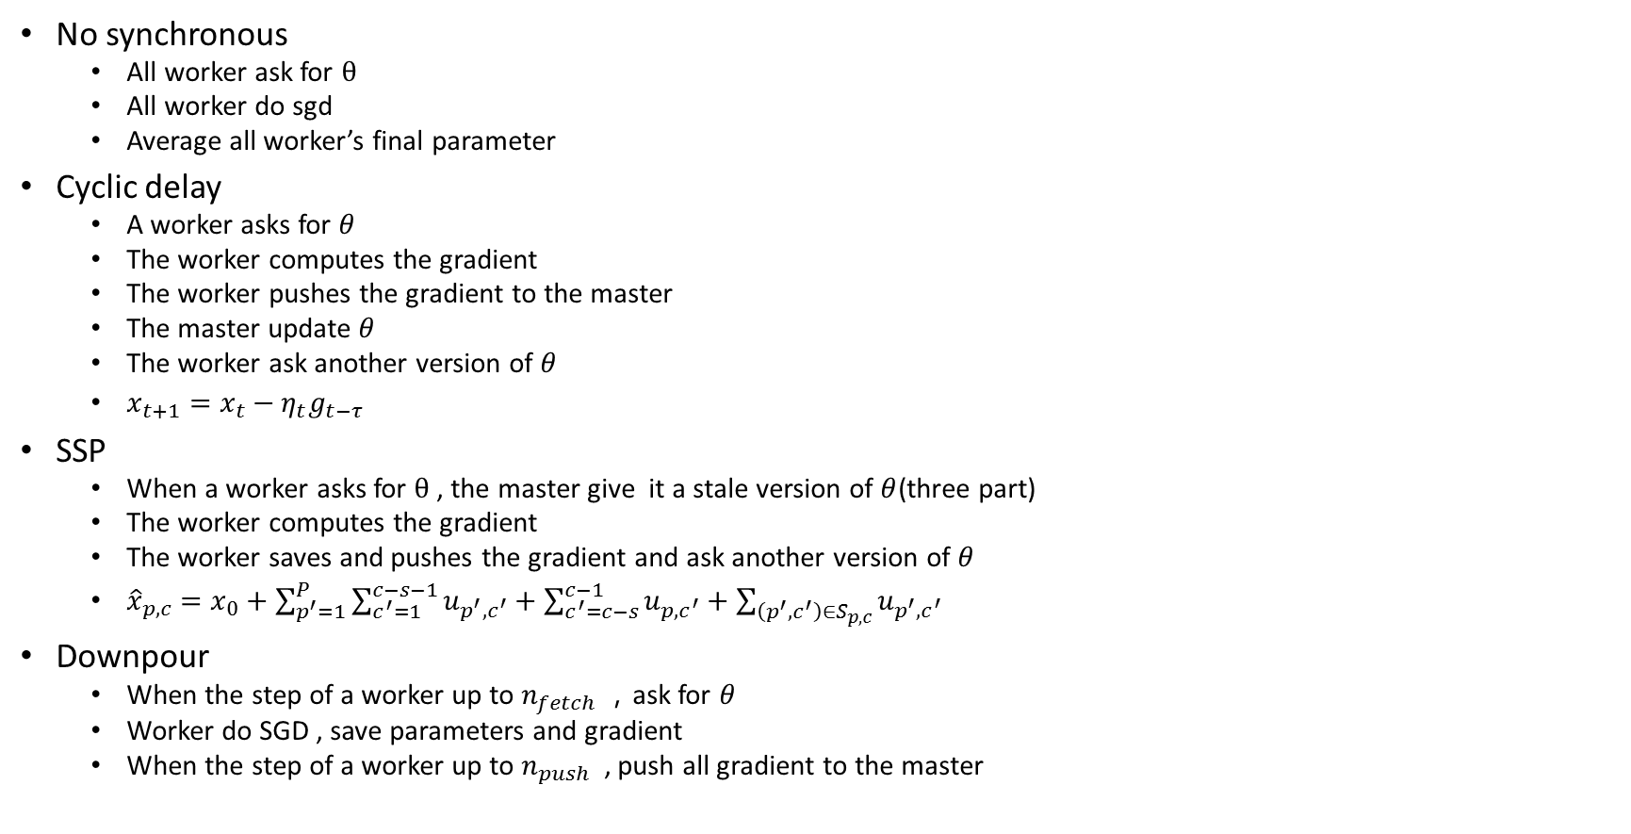
Under parameter server
No synchronous
All worker ask for $θ$
All worker do sgd
Average all worker’s final parameter
Cyclic delay
A worker asks for $θ$
The worker computes the gradient
The worker pushes the gradient to the master
The master update $θ$
The worker ask another version of $θ$
$x_{t+1}=x_{t}−η_{t}g_{t−τ}$
SSP
When a worker asks for $θ$ , the master give it a stale version of $θ$(three part)
The worker computes the gradient
The worker saves and pushes the gradient and ask another version of $θ$
${\hat{x}}_{p,c}=x_{0}+\sum_{p^{′}=1}^{P}{\sum_{c^{′}=1}^{c−s−1}{u_{p^{′},c^{′}}}}+\sum_{c^{′}=c−s}^{c−1}{u_{p,c^{′}}}+\sum_{\left(p^{′},c^{′}\right)∈S_{p,c}}{u_{p^{′},c^{′}}}$
Downpour
When the step of a worker up to $n_{fetch}$ ，ask for $θ$
Worker do SGD , save parameters and gradient
When the step of a worker up to $n_{push}$ , push all gradient to the master

Slide 8
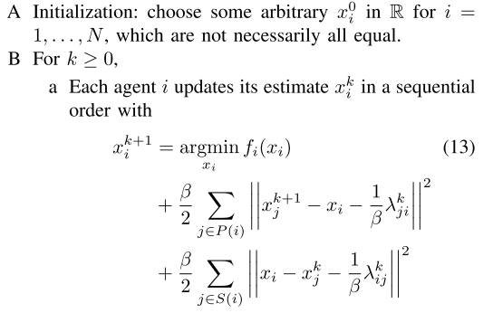
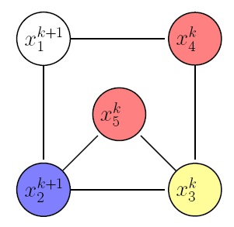
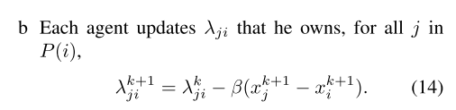
Decentralize

Slide 9
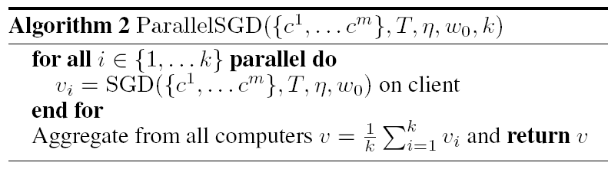
MapReduce framework

Slide 10
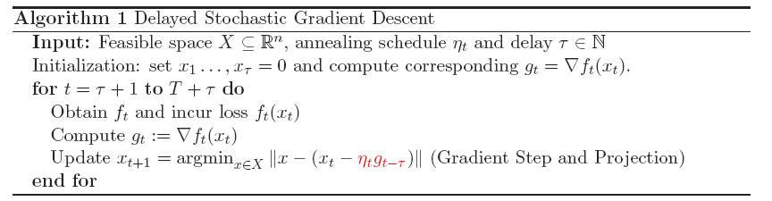
Lock
read / write-locking mechanism for x ,atomic updates on the parameter vector

Slide 11

$$p_{v}=b_{v}b_{v}^{T} G_{e}\left(x\right)=$$
Assume
only a single coordinate per sampled hyperedge is updated (i.e.,the for loop in Hogwild! is replaced with a single coordinate update);
the authors assumed consistent reads, i.e., it was assumed that while a core is reading the shared variable, no writes from other cores occur;
the authors make an implicit assumption on the uniformity of the processing times of cores (explained in the following), that does not generically hold in practice

Slide 12
original

Slide 13
downpour

Slide 14
ssp

Slide 15
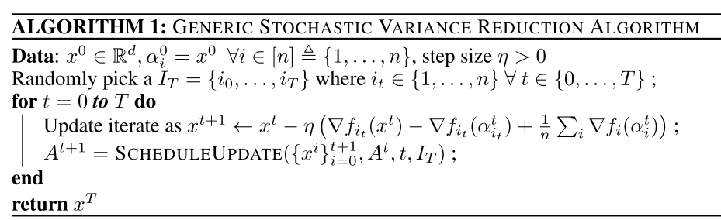
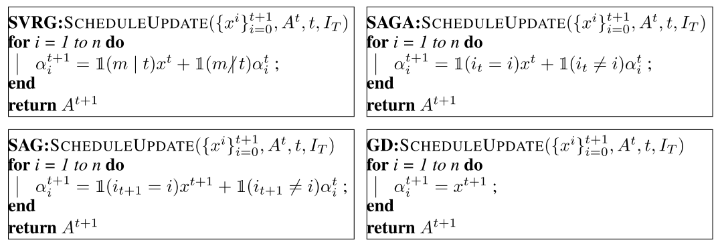

Slide 16
